Slide 1
Multivariate Displays
Unlocking Insights through Visualizations

Slide 2
Intro
Multivariate Displays: What Are They?
Seeing all your data at once.
Understanding everything together.
Smarter decisions, clearer insights.

Slide 3
Definition of Multivariate Displays
Multivariate displays are visual tools that show relationships among multiple things at once. They help us understand how different factors connect and interact in a single picture. These displays are like super-charts, giving us a complete view of data and making it easier to make smart decisions. By putting everything in one place, they help us see patterns and details that might be missed when looking at just one thing.

Slide 4
Types of Multivariate Displays
Scatter Plots
Heatmaps
Bubble Charts
Parallel coordinates

Slide 5
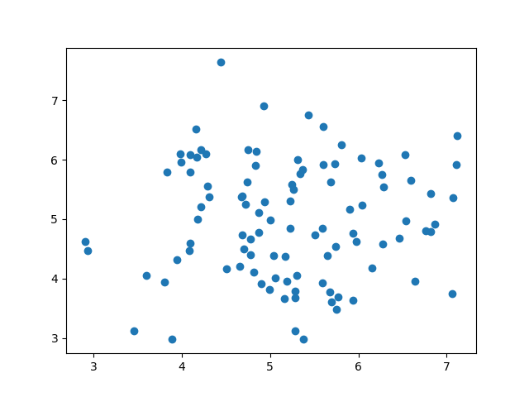
Scatter Plot
Graphical representation of the relationship between two continuous variables.

Slide 6
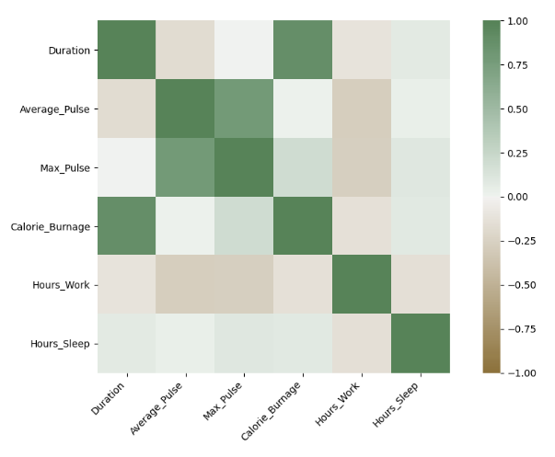
Heatmaps
Visual representation of data in a matrix format, where colors represent values..

Slide 7
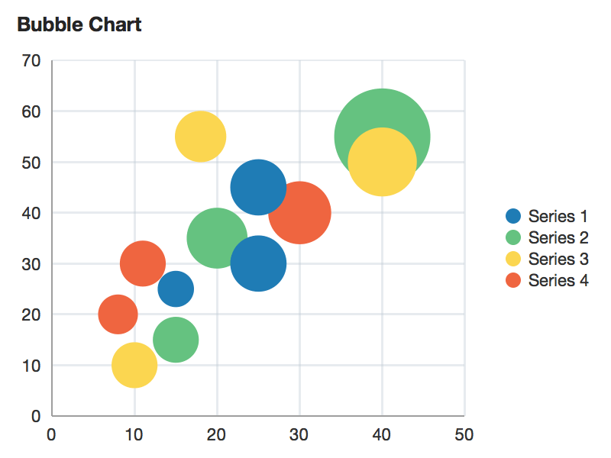
Bubble Charts
Scatter plot with an additional dimension represented by the size of markers (bubbles).

Slide 8
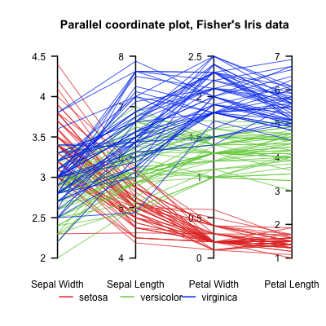
Parallel coordinates
Parallel coordinates are a common way of visualizing and analyzing high-dimensional datasets.
System of parallel lines representing different variables, with data points connected across these lines.

Slide 9
Advantages of Multivariate Displays
Efficient Data Exploration
Saves time in understanding complex datasets.
Comprehensive Insights
Reveals hidden patterns and correlations missed in univariate analyses.
Improved Decision-Making
Facilitates informed decisions through a holistic data view.

Slide 10
Best Practices for Creating Multivariate Displays
Keep it simple
Choose appropriate visualization types
Provide clear labels and legends

Slide 11
Thanks!

